Slide 1
Core Visibility on Campus
Jenn Page
Manager, ES Cell Targeting Core
Kirsten Copren
Director, HDCC Genome Analysis Core

Slide 2
Overview
Jenn Page-Importance of visibility for our Cores
Brain Turner-Tour of cores.ucsf.edu search site
Nick Larocque-iClicker “How can we improve the site?”
Linda Kittle-Discussion on these and other ideas
Jenn Page-New proposed sites with Core Families and landing pages
Coffee break activity-find your families
Jenn Page and Kirsten Copren-introduce landing page examples and a proposed format
Group activity-design your landing page
Linda Kittle-Discussion about each group’s draft, emphasize similarities and differences

Slide 3
Problem
Lack of awareness of available Core facilities leads to:
Wasted time-trying to reinvent the wheel, not focusing on priorities
Wasted money-investing in setting up techniques that may not be used often, outsourcing to external companies when facilities are available in house
Lost revenue for Cores-defeats the purpose of shared resource facilities
Many users in search of a Core may not know exactly what they need in order to find it
ex) A clinical lab needs whole genome sequencing on patient tissue samples
Who will extract gDNA?
Who will do the library prep and sequencing?
Where is there a sequencer that they can run their samples on and how much will it cost?
How do they receive, store, and analyze their data?

Slide 4
What we currently have available
Cores.ucsf.edu-search by service
RRP Shared Resource Facilities page-grouped into rough categories
ex) A clinical lab needs whole genome sequencing on patient tissue samples
Who will extract gDNA?
Who will do the library prep?
Where is there a sequencer that they can run their samples on and how much will it cost?
How do they receive, store, and analyze their data?

Slide 5
Planned Improvements to cores.ucsf.edu
New Core “families”-grouped by similarity
Each Core can be a member of as many families as seem right
Each family will have a landing page describing the overall services provided and links to each individual core’s website

Slide 6
Proposed new families
Genomics
Imaging-radiology
Imaging-microscopy
Bio-banking and specimen repository
Mass spectrometry-small molecule and proteomics
Computational and Informatics
Clinical
Flow cytometry and immunology
Animal and cell line generation
Miscellaneous

Slide 7
Some Cores may be hard to place into a family
Genomics
Imaging-radiology
Imaging-microscopy
Bio-banking and specimen repository
Mass spectrometry-small molecule and proteomics
Computational and Informatics
Clinical
Flow cytometry and immunology
Animal and cell line generation
Miscellaneous
EASY:
ES Cell Targeting Core
- novel mouse and cell line models
- Custom genome editing
HARD:
Preclinical Therapetics Core
Animal xenograft models
Small molecule (drug) testing

Slide 8
Coffee Break activity
Take several colored index cards (one for each proposed family you feel your core can fit into), write the name of your core on each
Place your cards on the large sheets for each family you feel your core can fit with
Decide which family is the best fit for your core and join their table for the group activity

Slide 9
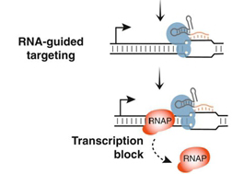
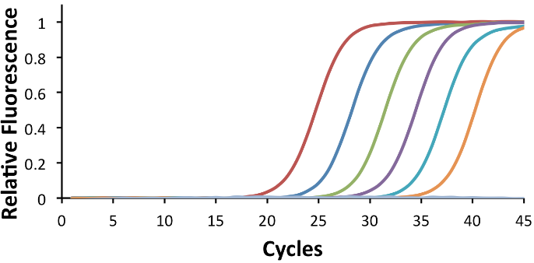
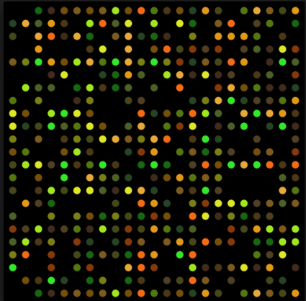
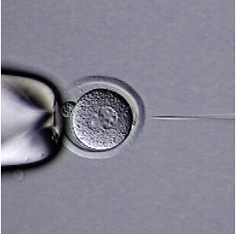
Sample layout
Genomics Family of Cores
Genomics services range from new model generation using CRISPR genome editing, to analysis of genomes through techniques including (but not limited to) qPCR, DNA sequencing, and microarrays
Model Generation
Raw data (sequencing/SNP analysis/microarrays)
Informatics and Data Analysis
QC/Validation/Processing/Library Prep
Nucleic Acid Isolation
ES Cell Targeting Core
CRISPRa, CRISPRi/Genome Editing
Jennifer Page, Manager
ES Cell Targeting Core
gDNA, RNA extraction
Jennifer Page, Manager
Genome Analysis Core
qPCR
Kirsten Copren, Director
Center for Advanced Technology
Sequencing, Arrays
Eric Chow, Director
Gladstone Genomics Core
QC, Library Prep, qPCR
Robert Chadwick, Director
Transgenic Gene Targeting Core
CRISPR/Genome Editing
Junli Zhang, Director
UCSF ViraCore
Michael McManus, Director

Slide 10
Core Families Group Activity
With your Core Family, draft a landing page conveying all the information you feel is most relevant to users of your cores
You can follow the template provided or deviate as you see fit
At the end we’ll discuss what elements you kept and what you changed, and decide as a group which elements should be consistent for all the families and which ones can be customizable

