Slide 1
Data Management for NIH and Beyond
Ariel Deardorff, MLIS
Data Services Librarian
NLM Associate Fellow
UCSF Library
June 9, 2016
Notes:
Introduce self
Going to be talking about data management
Combination of NIH requirements and best practices
From the perspective of the researchers – people using your facilities, yourself as a researcher

Slide 2
Today: data Sharing Data Storage and Documentation
Notes:
This is going to be from the perspective of the researcher, both for the people that use your cores and your own research work
First we are going to talk about data sharing- covering what the requirements are and how to meet them
Then we will talk about data storage and documentation, where to keep your data and how to organize it
This might seem a little backwards but actually data sharing regulations and repository requirements can have a huge impact on how you decide to manage and document your data

Slide 3
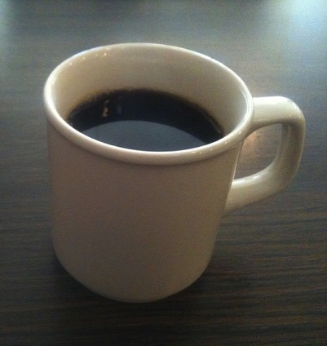
Could your data survive this?
Notes:
Think about your data and the way it is currently maintained.
How easily could you recover from a fire, spilled coffee or the passage of time?
Will it still be accessible 5 years from now
Flow flow cytometry data, micrarray, imaging data, proteomic,
Images:
Fire: https://flic.kr/p/sRqX2
Coffee: https://flic.kr/p/8xLUqc
Time: https://flic.kr/p/eHP58S

Slide 4
Does your data enable this?
Notes:
How easily could you share your data with collaborators or upload to a data repository?
If you are generating data for someone else it easy for them to see what you did?
Hit by the bus principle: how easy would it be for your collaborators/post-docs to pick up your work and understand it.
When we really think about it lots of us have messy, unorganized data that make it hard to collaborate and share. Today I am going to cover NIH requirements and general best practices that will make it easier for you to manage your research data

Slide 5
Data sharing
Notes:
The reason I like to start with data sharing is that it is increasingly becoming mandatory for biomedical researchers
New rules and requirements are popping up constantly
Can really impact how you store and organize your data
Before we talk about the requirements lets talk about why you might want to share your data

Slide 6
Data Sharing – the Carrot
Making your research data available in a public repository:
Helps confirm original results, gain confidence in your novel results
Generate new hypotheses
Develop new analysis techniques and test software tools
Supports more efficient use of funding by avoiding duplicate data collection
Encourages reproducibility/Discourages fraud
Facilitates collaboration
Get credit for data reuse/citation
Notes:
Something you might consider as you are coming to the end of a project/another reason you might use a data archive
Why you might want to

Slide 7
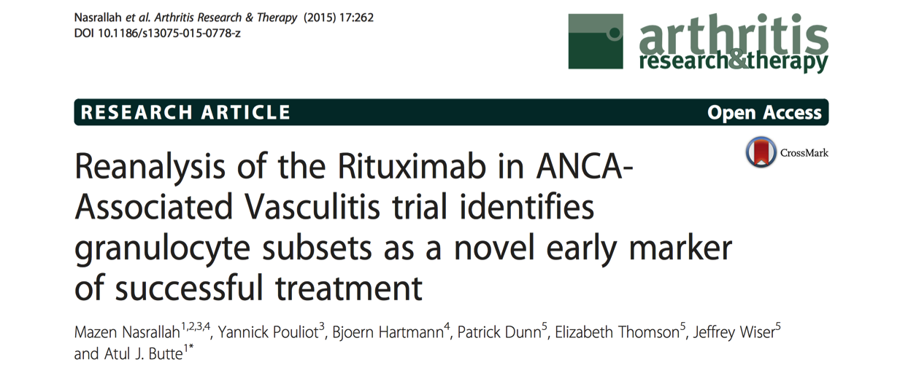
Data Sharing - Example
Notes:
Article published in Arthritis Research and Therapy
Authors from the UCSF institute for computational health sciences
Pulled clinical and flow cytometry data from the Immune Tolerance Network’s Trial Share repository
Sponsored by NIAID
To look for biomarkers in patients that achieved remission with Rit-ux-amab or cyclo-phos-phamide versus those that did not
identified distinct subsets of granulocytes that predicted whether the patient was more likely to achieve remission with cyclophosphamide or rituximab
Great example of a study that used already available data for analysis and generated new knowledge
Were able to avoid a new clinical trial, saving money and patient time

Slide 8
Data Sharing – the Stick
Required by:
Notes:
Why you might have to:
Funded by any of these?
Planning to publish in any of these
More and more funders and journals are requiring it

Slide 9
NIH General Requirement
“Investigators seeking $500,000 or more in direct costs in any year should include a description of how final research data will be shared, or explain why data sharing is not possible”
Notes:
Let’s talk requirements: first we have the nih data sharing plan requirement

Slide 10
Example NIH Data Sharing Plan
Notes:
Highlight key bits
- Quite easy as of now – coming out with a more detailed/rigorous plan requirements sometime this year

Slide 11
NIH Genomic Requirement
“The GDS Policy applies to all NIH-funded research (e.g., grants, contracts, intramural research) that generates large-scale human or non-human genomic data, regardless of the funding level, as well as the use of these data for subsequent research. Large-scale data include genome-wide association studies (GWAS), single nucleotide polymorphisms (SNP) arrays, and genome sequence, transcriptomic, epigenomic, and gene expression data.”
Notes:
Who does it apply to

Slide 12
NIH Genomic – What to Include
Description of data type
Data repository
Data submission and release timeline
IRB assurance of plan
Appropriate use of the data
Request for exemption
Notes:
What do you have to do as part of this policy?
What type of genomic? Sequence, transcriptome. Individual or aggregate level?
Where will you submit the data what will be the level of access?
For human it should be registered in DBGap and then the data submitted to the relevant NIH repository (GEO< Sequence Read archive, etc)
When will you share the data?
In general the NIH will release data no later than 6 months after it has been submitted or at the time of acceptance of the first publication
Did someone from your IRB board look over the plan?
What is the appropriate use of the data? If broad use of the data for research is not appropriate you should explain why not
Describe why you cannot share human data and what your alternative plan might be

Slide 13
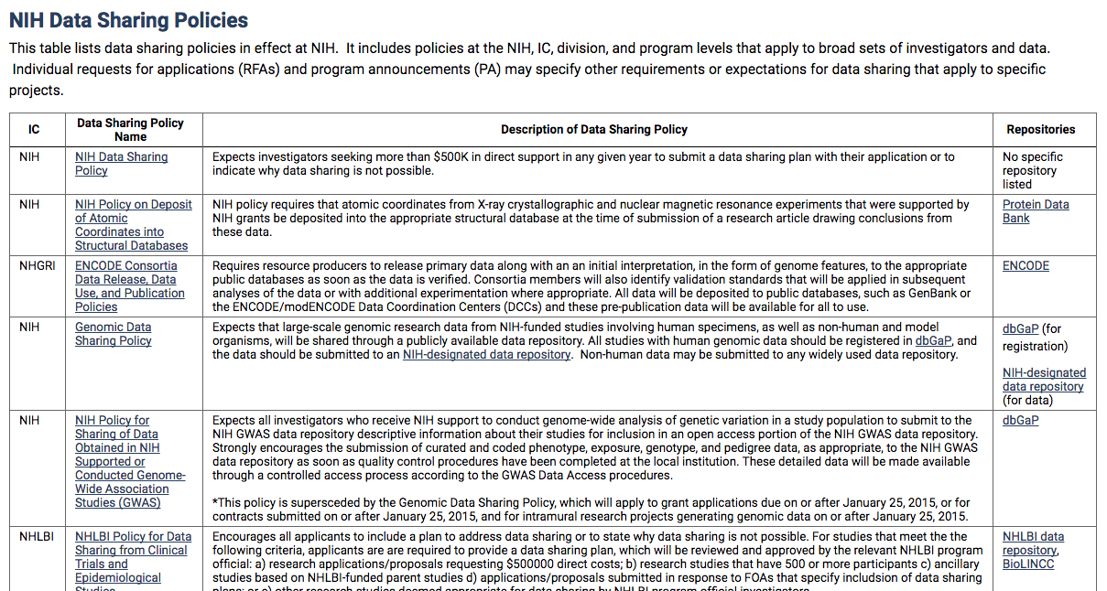
Other NIH Requirements
Notes:
Lots of other policies, might be one out there for another institute you are funded by:
Ex: policy on atomic coordinates from x-ray crystallography, NIAID funded immunology data, NIDA (drug abuse) data sharing policy

Slide 14
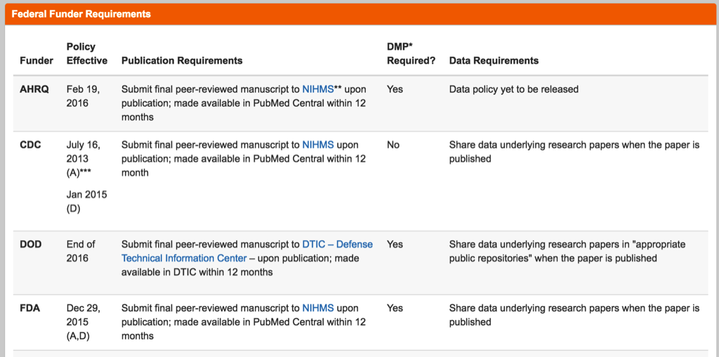
Other Government Funders
Notes:
More and more federal agencies are releasing publication and data sharing plans. We have a table on our library website to track the different requirements. Link at the end

Slide 15
Other Funders
Notes:
Not just the federal funders – many other state funders and private foundations are releasing data sharing requirements

Slide 16
DMP Tool
Dmptool.org (sign in with MyAccess)
Free UC tool for building data management plans
Walks you through the different sections of the plan
NIH and NSF templates available
Get ideas from publically available plans

Slide 17
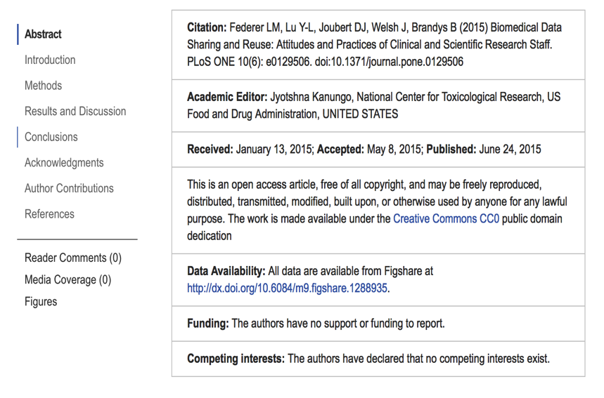
Journal Requirements
Notes:
Not just funders – more and more journals are requiring data sharing as a condition of publication
This is what really drives data sharing – we see it all the time that people don’t think about it until they get to this point and then it is a lot of work. We want to encourage you to think ahead
Science
Must deposit large data sets (microarray, DNA sequences, etc) into approved databases
Should follow MIBBI guidelines (MIAME – Microarray or MIAPE – Proteomics)
PLOS:
Make data fully available
Provide a data availability statement (have to prove it, part of the paper)
Refusal to share data is grounds for rejection

Slide 18
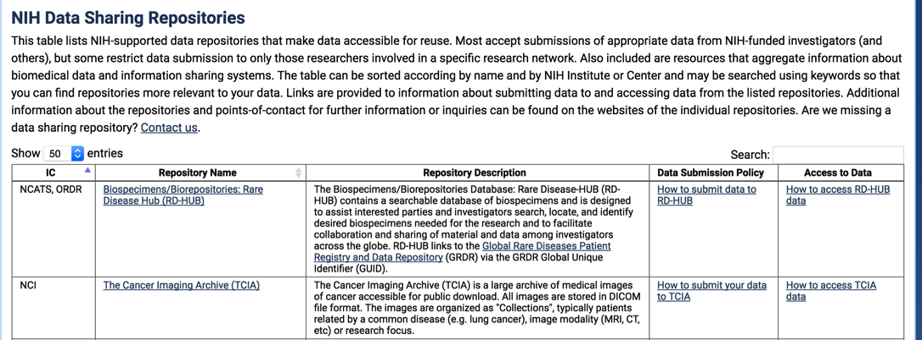
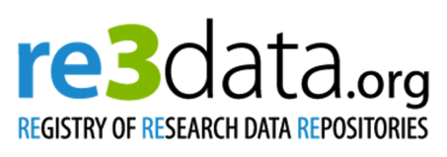
Data Repositories
Notes:
Where should you be sharing your data?
Many ways to share but the way that most funders and journals recommend is to put it in a data repository
NIH supported data repositories – for specific institutes
Find the standard repository for your data type
Re3data lists over 1500 data repositories, can browse by discipline, access agreement
Look for places with similar data types

Slide 19
Data Repositories

Slide 20
UCSF DataShare
Notes:
Place to share data
Easy, low-cost option for data sharing
Built in best practices – DOI, citation
For data that doesn’t fit elsewhere
For data that isn’t necessarily associated with a publication

Slide 21
Data storage and documentation
Notes:
Once you know that you have to share your data and you have identified a useful repository then what?
Read over the requirements for depositing your data and let that guide your methods of managing your data throughout your research project

Slide 22
Storage
3
2
1
Copies of your data
Types of Media
Copy offsite
Notes:
Follow the 3-2-1 rule
Images: three copies of your data, in two types of media, at least one of which is offsite
Make it easier to withstand fire/cup of coffee

Slide 23
UCSF storage solutions
UCSF MyResearch
Notes:
MyResearch: secure, PHI data
Box: non-PHI data, now with unlimited storage – soon to offer PHI approved folder
UCSF IT: custom data storage solutions
Many of you have your own servers/it teams
Are you using non-ucsf cloud storage? Amazon?
Wherever you keep your stuff:
Make Backup copies and check them
Don’t forget to make copies of physical notes or notebooks
CrashPlan Pro is the UCSF enterprise backup system

Slide 24
Documenting Data
Research Project
Readme File
Dataset
Data Dictionary
Notes:
Research Project: Rational and context for data
Data collection methods
Structure and organization of files
Data sources uses
Data validation and quality assurance
Transformation of data
Info on confidentiality, access and use
Dataset
Variable name and description
Explanation of codes and classifications
Algorithims/computer codes used
File format and software version used

Slide 25
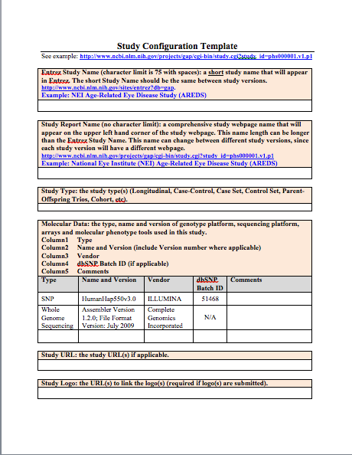
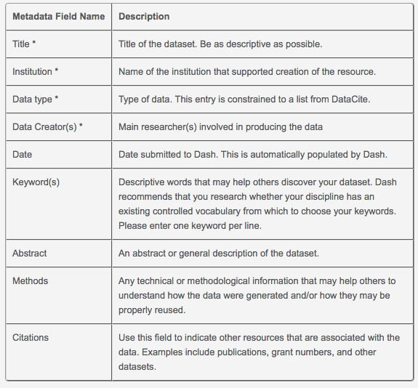
Readme File
For yourself
For a repository
Notes:
Study Level information
Readme file: good first step
For you and others who might work on your project/work with this data
A way to share the structure of your files and folders
Explain the purpose of the project
Relevant summary and contact details
General organization of files
If submitting to a repository:
DataShare Example, doesn’t require much but you can include a readme file along with the data. Some of the general repositories wont require much
DBGap example (5 pages): description of the study, inclusion/exclusion criteria, relevant publications, etc. Similar to requirements for many of the NIH repositories

Slide 26
Data Dictionary
Notes:
Data set level information
Check their requirements!
Example of a data dictionary from DBGap
You are going to have to create it eventually so you might as well start
One more example
Not sure what to include: consult one of the MIBBI frameworks – by experimental data type
Planning for the future
Organize it the right way from the start

Slide 27
Electronic Lab Notebooks
Notes:
More and more people are using or starting to use electronic lab notebooks for their documentation.
The library is interested in learning more about which products you are using, we are planning on having an electronic lab notebook fair

Slide 28
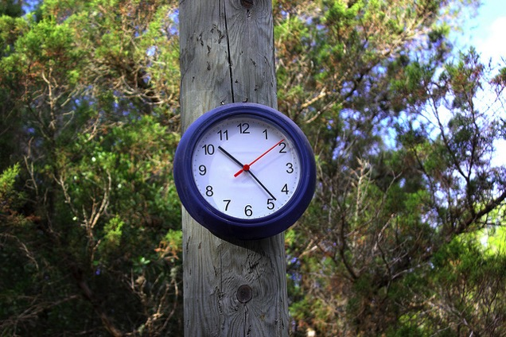
Data Retention
Varies
Generally 3-7 years
Notes:
This is a little tricky
NIH does not have blanket requirements – can vary from project to project/grant to grant
UCSF also does not have a requirement
there is a group working on this
Time: https://flic.kr/p/dtgLMo

Slide 29
What to Keep
Informed consent
IRB documentation
Animal welfare records
Financial documentation
Lab notebooks
Drug accountability records
Regulatory records

Slide 30
How to Keep it
Image
JPEG
Text
Tabular
TXT
PNG
TIFF
HTML
XML
PDF
CSV
Video
MP4
TAB
Notes:
General:
non-proprietary
Open, documented
Common usage
Unencyrpted, uncompressed
Migrate to new formats as they emerge

Slide 31
Where to Keep It
Notes:
Store in a data repository or archive to ensure long term access

Slide 32
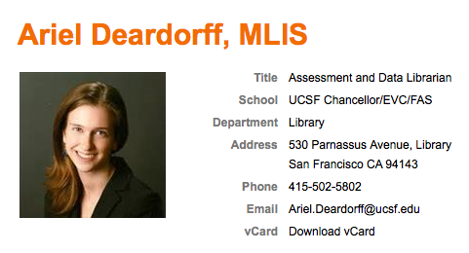
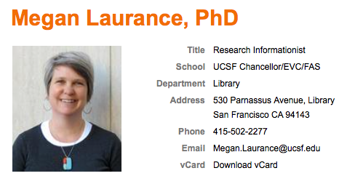
UCSF Resources
Data Management guide: guides.ucsf.edu/datamgmt
Notes:
What can people come to us to talk about
Need a repository for your data type
Help writing a data sharing plan
Submitting to a repository
Refer to other services on campus

Slide 33
Questions?

Slide 34
Creative Commons Images
“Fire” by Liz West on Flickr. CC BY 2.0
“Full House Café” by evan p. cordes on Flickr. CC BY 2.0
“Clock” by Jurgen Leckie on Flickr. CC BY-ND 2.0
“Time…” by David Vega on Flickr: CC BY 2.0

