Slide 1
Supply Chain Management

Slide 2
We are you’re A-Team
Logistics
Procurement Systems
Purchasing
Sourcing
Disruptors
Research Advocates
Innovators

Slide 3
saves you time
4,500
Active users in March 2016
PO’s created per month
16,000
4,000,000
Catalog items with excellent Terms and conditions

Slide 4
We save you money
UCSF Supply Chain team has led all other UC Campus procurement teams in value generation for the past 3 years.
* 2015/2016 Savings from BenefitBank program and pulled from SpendRadar. All other years are from UCSF Strategic Sourcing records.
Notes:
Key projects:
- Biobanking software
- Research Gases reduced helium costs from $24/L back down to $6/L
- Dry Ice project reduced delivery fees and slashed the cost from $0.29 to $0.24
- Recycled Paper project increased utilization of 100% PCR paper and reduced the cost by $8 per case.

Slide 5
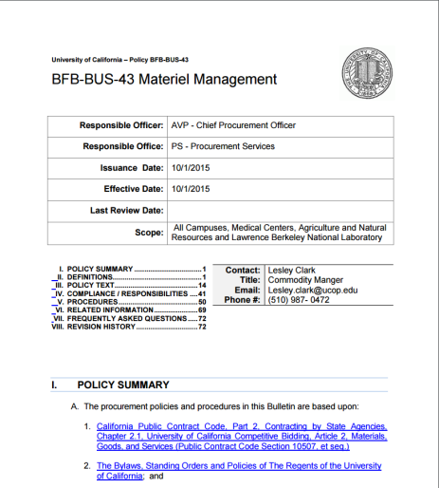
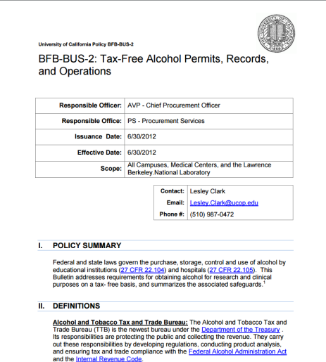
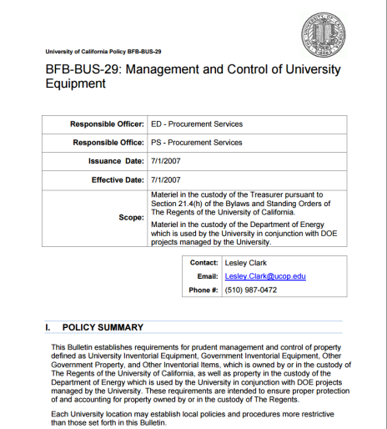
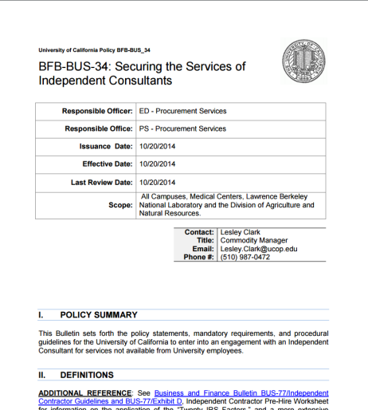
We help with policy
We help keep you compliant with the 12 different UC procurement policies
Notes:
Compliance with policy can make your life difficult. In many cases, our policies align to California/Federal laws and breaking them could land you in a bit of hot water. Our processes are aligned to satisfy UC policy and applicable laws, so that none of us end up on the front page of the chronicle or in the middle of a scandal or in prison.
Examples:
- UC was recently sued by a supplier for breach of contract. PI broke a number of policies and ended up in the middle of a messy lawsuit.
- Many years ago (before my time) a UC official was arrested by the FBI for crimes related to tampering with federal bids.
- Most common… We often make people start all over if they break enough policies that we cant salvage the process.+

Slide 6
How/When do I engage?
When:
When you have money to spend, know what you want, and know what it will do for you.
When you have administrative turnover or need help structuring your procurement activities.
How:
Email or call your department buyer; they are happy to provide advice.
Email BearBuy@ucsf.edu and we can send your buyer to you for an introduction.

Slide 7
Some known issues
Timing SCM engagements
Contact us early for consultation on how to procure your equipment.
Demos
We can help structure agreements for Demo equipment.
Price
We have access to pricing people paid for equipment across multiple UC campuses and often times the quotes too.
Notes:
We encourage you to inquire early with your buyer about how to conduct the procurement.

Slide 8
Questions?
SCM loves it when a plan comes together

