Slide 1
RRP Annual Retreat June 9, 2016
PMO.ucsf.edu
Introduction
UCSF Program Management Office
Notes:
This presentation is constructed using UCSF’s recently released Brand Identity model. See http://identity.ucsf.edu/powerpoint for more details.

Slide 2
Program Management Office
Internal business advisory unit of skilled professionals who provide consulting services to the UCSF campus
Projects that entail complex logistical, technological, process, and management factors.
Work with schools and central leaders and their department staff to implement both campus-wide and unit-specific operational improvements.

Slide 3
PMO Key Service Offerings
Strategy Strategic Planning, Initiative Envisioning, Project Scoping
Process
Business Process Redesign, Implementation, and Kaizen Workshops
Technology
Systems Implementation from Software Selection Phase through System Go-Live
Organization
Organization Alignment, Restructuring, consolidation & Shared Services
Project Management, Facilitation, Change Management, Training and Lean Methods
as a component of delivering the above services or as independent functions
3

Slide 4
Sample UCSF Projects
Strategic Planning, Initiative Envisioning, Project Scoping
Security and Safety Task Force, Spring 2016
UC wide P200 Strategic Workshop Planning, Fall 2015
RMS Strategic Planning Retreat, Feb 2015
Business Process Redesign and Implementation / Kaizen Workshops
Core Immunology Lab, Spring 2016
Asset Management – large research equipment, Spring 2016-ongoing
FSC Cash Handling, Spring 2015
Cell Culture Facility, Spring 2015
Post Award, Controller’s Office, Spring 2015
Chancellor’s Executive Committee, BPI Toolkit, Fall 2014
Systems Implementations (from Software Selection through System Go-live)
BIOS Program: Requirements Gathering, April 2016-June 2016
CRM, July 2015-ongoing
E-Value for SON Clinical Placement 2015 and Course Evaluation 2016
Biobanking Software Selection, Spring-summer 2015
Administrative Systems, 2002-2010
Organization Alignment, Restructuring, Consolidation & Shared Services
Clinical Trials Office Spring 2015
Operational Excellence, 2008-2011
Project Management, Facilitation, Change Management & Lean Methods (in addition the above areas)
Career Tracks Roll out, Summer 2016
DUO 2 Factor Rollout, Spring 2015

Slide 5
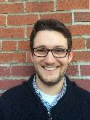
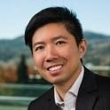
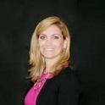
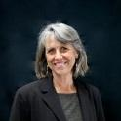
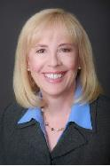
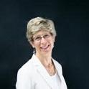
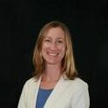
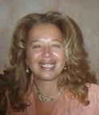
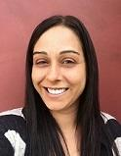
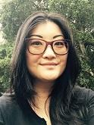
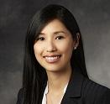
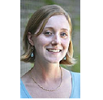
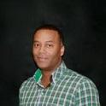
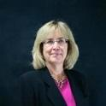
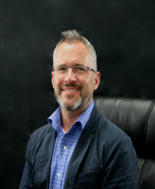
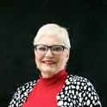
The PMO Team
Our Headcount
16
Our Schooling:
Brandeis
Brown
Mount Holyoke
Middlebury
NYU
Raymond
SFSU
SJSU
UCB
UCSD
UKansas
UNH
UHawaii
UIndiana
UWisconsin
UTexas
Yale
Our Credentials:
5 MBAs
4 MS, MPH, MPS, MPP
3 PMPs
4 Certified Lean Practitioners
Cumulative Years Experience
120 yrs in UC
100 yrs in Management Consulting
5

Slide 6
Today’s Participants
Linda Kittle, BA, MBA, Director & Senior Program Manager
Thirty years experience in higher education, non-profits and at multiple UC campuses and the Office of the President
Focus areas include strategic planning, process improvement, change and project management and organizational alignment
Variety of higher education settings including Academic, Business, IT, Development, and Student Affairs
Previous to UCSF, Special Assistant to the Executive Vice Chancellor/Campus Provost at UCSC
Paul Sullivan, BA, MBA, Program Manager
Over fifteen years of management experience in technology, business and higher education
Focus areas include process improvement, business analysis, change management and IT implementation projects.
Paul is certified in Lean operations and management
Previous to UCSF, Business Analyst, IBM

